Slide 1
Introduction to Machine Learning
Group 4

Slide 2
Handling missing data
# fill missing values with median column values
df[numerical_cols] = df[numerical_cols].fillna(df[numerical_cols].median())
# Replace missing values in other categorical columns with 'Unknown'
for col in categorical_cols:
df[col].fillna("Unknown", inplace=True)
Categorical columns:
Replace missing values with 'Unknown' and 'NA'
Numerical Columns:
Replace missing values with median
We tried handling categorical missing values by using: SimpleImputer(strategy='most_frequent’) but this lead to a worse performance

Slide 3
Encoding Categorical Features
# Convert categorical columns to numeric using get_dummies encoding
df = pd.get_dummies(df, columns=categorical_cols)
We end up with 305 columns
Tried classifying ['MSSubClass', 'OverallQual', 'OverallCond’] as categorical values, but this lead to a worse performance

Slide 4
Feature Engineering
df['TotalSF'] = df['TotalBsmtSF'] + df['1stFlrSF'] + df['2ndFlrSF']
df['TotalBath'] = df['FullBath']+ df['BsmtFullBath'] + 0.5 * (df['HalfBath'] + df['BsmtHalfBath'])
df['TotalPorchSF'] = df['OpenPorchSF'] + df['EnclosedPorch'] + df['3SsnPorch'] + df['ScreenPorch']
df['HasPool'] = df['PoolArea'].apply(lambda x: 1 if x > 0 else 0)
df['HasFireplace'] = df['Fireplaces'].apply(lambda x: 1 if x > 0 else 0)
df['HasGarage'] = df['GarageArea'].apply(lambda x: 1 if x > 0 else 0)
df['HasBasement'] = df['TotalBsmtSF'].apply(lambda x: 1 if x > 0 else 0)
df['YearsSinceRemodel'] = df['YearRemodAdd'] - df['YearBuilt']
8 new features
Notes:
Combined existing features to create 8 new features
3 "Total" features (summation of related features)
4 binary features (1 if feature exists, 0 if not)
1 feature for remodeling and building dates
Correlation checks conducted to assess usefulness
Top correlated features with "Class":
"TotalSF"
"TotalBath"
"HasFireplace"

Slide 5
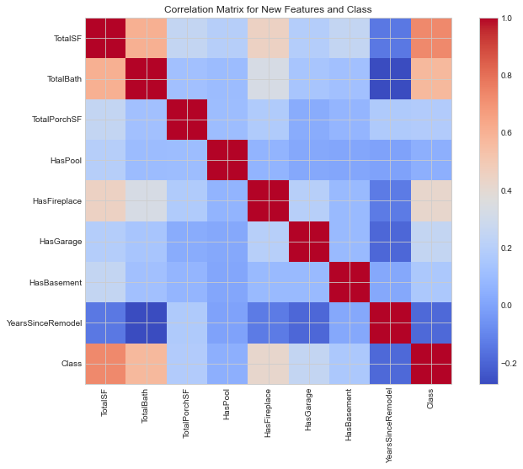
Feature Engineering (cont.)
Combined existing features to create 8 new features
3 "Total" features (summation of related features)
4 binary features (1 if feature exists, 0 if not)
1 feature for remodeling and building dates
Correlation checks conducted to assess usefulness
Top correlated features with "Class":
"TotalSF"
"TotalBath"
"HasFireplace"
Notes:
Even though some of the new features do not have a high correlation with 'class' we will not remove any features, as this will be done automatically later.

Slide 6
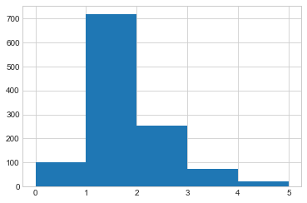
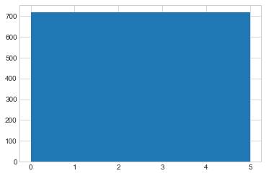
Balancing Dataset through Upsampling
# Handle class imbalance using oversampling with SMOTE
smote_nc = SMOTE(random_state=42)
X_resampled, y_resampled = smote_nc.fit_resample(X_train, y_train)
Class 1 is overrepresented
Upsampling with SMOTE (only on the training set)
Before upsampling
After upsampling

Slide 7
Selecting Most Significant Features
# Feature selection using Extra Trees Classifier on the resampled training data
model = ExtraTreesClassifier(random_state=42)
model.fit(X_resampled, y_resampled)
importances = model.feature_importances_
# Select top 300 features with highest importance scores
top_features = pd.Series(importances, index=X_resampled.columns).nlargest(300)
Importance of feeding the model with relevant data
Irrelevant data = noise
Noise can decrease model performance
Focus on high-quality, relevant inputs for optimal results

Slide 8
Random Forest: Parameter Finetuning
rf_params = {
'n_estimators': [1000, 1670, 2000],
'criterion': ['gini', 'entropy'],
'max_depth': [10, 18, 25, None],
'min_samples_split': [2, 3, 5],
'min_samples_leaf': [1, 2, 4],
'min_weight_fraction_leaf': [0.0, 0.1, 0.2],
'max_features': ['sqrt', 'log2', None],
'max_leaf_nodes': [None, 100, 500, 1000],
'min_impurity_decrease': [0.0, 0.1, 0.2],
'bootstrap': [True, False],
'oob_score': [True, False],
'n_jobs': [None, -1],
'class_weight': ['balanced', 'balanced_subsample', None]
}

Slide 9
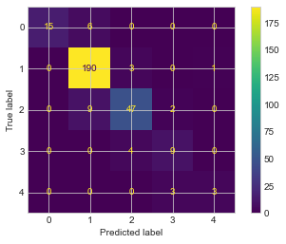
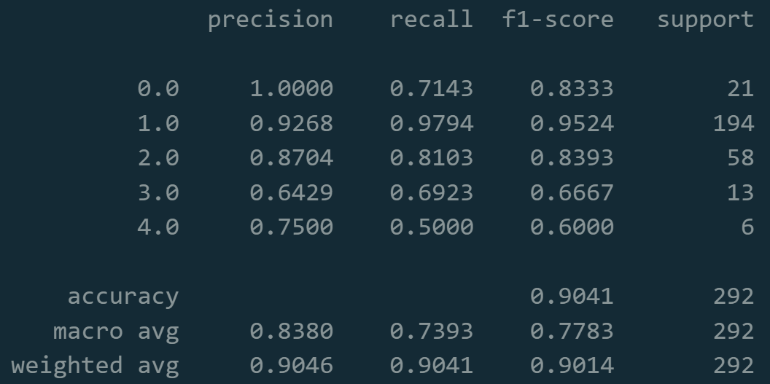
Performance
Confusion Matrix
Classification report

Slide 10
Performance (cont.)
Without feature engineering:
weighted avg 0.8874 0.8870 0.8835 292
Without upsampling:
weighted avg 0.8796 0.8801 0.8747 292
Without feature engineering and upsampling
weighted avg 0.8780 0.8801 0.8751 292
With feature engineering and upsampling:
weighted avg 0.9046 0.9041 0.9014 292

